Slide 2
EE 295
TechWriting-Engineering Ethics
Aug 27, 2019
Room E339
Tom Wrappe
EE Lecturer

Slide 3
First Writing Rules
Ethics and Engineering
Upcoming Week

Slide 4
First Writing Rules
Six Step Approach for Tech Writing
Checklist for Tech Writing

Slide 5
Blank Page Quandary
The world is doing just fine without my paper right now, why should I create it?
How do I get started?
How do I finish? When do I stop?
How do I measure the Quality?
There is no single way to create a written project, but a framework provides guidance and direction

Slide 6
Technical Communication for Engineers Six Step Approach to Writing
Dr. James J Freeman
&
Nancy S. Freeman Ph.D.
Technical Communications/Editing
Consultant

Slide 7
Purpose
This session presents the Six Steps to Reader-Centered Writing that was developed by a well known educator, Deborah Dumaine.

Slide 8
Six Step Method to Reader Centered Writing
Step 1 Analyze your purpose and audience by using the Focus Sheet
Step 2 Generate Ideas by using a start-up strategy
Step 3 Organize your information
Step 4 Sequence your ideas. The “bottom line” message should go on top– most of the time
Step 5 Write the first draft
Step 6 Edit for clarity, conciseness and accuracy

Slide 9
Adaptable Black Box Approach to Tech Writing Process
Content
Clear Conclusion
Concisely Stated
Well Supported
6 Edit
2 (Ideas), 3 (Organize), 4 (Sequence)
Generate Technology
Document
(FPGA)
5 Draft
EE 295 Rules
Rules
Grammar
295 No No’s
Plagiarism
Inputs
Step 1: Configured to Meet type of Document
-Product Description
-Patent application
-Business Case
-Research Paper
(Firmware)
Output
Metrics

Slide 10
Step 1 Focus Sheet
The answers to these questions are the first step in any writing project. They include the Purpose, Audience, Bottom Line, and Strategy.
1. Purpose
Why am I writing this?__________________________________________
What do I want the reader to do?______________________________________
2. Audience
Who is/are my reader (s)?____________________________________________
What is the reader’s role?___________________________________________
What does the reader know about the subject?____________________________
How will the reader react?____________________________________________
What is my reader’s style? Should I adjust to it?___________________________
How will the reader use this document?__________________________________
Who should I include in this mailing?_____________________________________

Slide 11
Step 1 Focus Sheet
3. Bottom Line
What one point do I want remembered?________________________
________________________________________________________
Strategy_____________________
Should I include deadlines? Actions requested?
Is someone communicating the same information? Should I check with that person?
Is my method of transmission best. Should I use email, fax, or traditional mail?
Developed by Deborah Dumaine

Slide 12
Discussion of Step 1
Why am I writing this? Here are a few typical reasons for writing:
To request
To inform
To analyze
To propose
To respond
To explain
To recommend
To report findings
To announce

Slide 13
Step 1
Analyze your audience
a. Who is your reader?
b. What are your readers’ expectations?
c. Why and how will readers use the document?
d. Categories of readers.
1. Expert
2. Technician
3. Manager

Slide 14
Step 1
Bottom Line
What is the one idea you want the reader to remember? The sooner you can get this down to one or two sentences the faster you will be able to write. If you are having trouble with this, finish the rest of the Focus Sheet and return to this part

Slide 15
Step 1
Strategy
Make sure that the timing of your communication is correct.
Keep the results you want in mind and make your requests as clear as possible.

Slide 16
Step 2 Generating Ideas
Getting started is sometimes the hardest part of writing!
To lower the barrier to generating ideas, write ideas as they come, in no particular order
Developing a plan, or strategy, will help you use your writing time more efficiently.

Slide 17
Step 2 Generating Ideas
1. Put all of your ideas down on paper to:
a. see if your information is complete
b. decide what to use and what to omit
c. organize an effective presentation.
d. think or brainstorm to get out all your ideas without committing to their importance or the order in which you will use them
2. Researching additional information
a. Find out what is already published
b. Evaluate the information
c. Gather new information

Slide 18
Step 3 Group Information Under Headlines
Now it is time to group related ideas. The possibilities are numerous. Here are some:
Statement of purpose
Proposal
Request for Action
Rationale for Action
Background Information
Explanation of a process
Results of a Study
Conclusions
Observations
Evaluation
Implementation Plan
Recommendations

Slide 19
Step 3 Organize the Info
Typical Categories for Status Reports
1. Executive Summary
2. Project Description
3. Current Status
4. Successful Aspects
5. Problems Encountered
6. Planned Solutions
-further information needed
-opinion needed
-decision needed
-request for confirmation of plan

Slide 20
Step 3 Organize the Info
Other projects completed– summary of each
Other projects still in progress
background
status
forecast of
a. time schedule
b. changes
c. cost
9. Summary and Conclusion

Slide 21
Step 3
Proposal
1. Abstract/Summary
2. The proposal stated
3. Supporting reasons
4. Plan scope
schedule
budget
implementation
5. Points to investigate further
other people involved
time factors
6. Conclusions restate
restate recommendation/proposal

Slide 22
Step 4 Sequence your Ideas
Your completed Focus Sheet will help you develop a Method of Development which then determines the paragraph sequence. Among the most common are:
1. Order of Importance- most to least or least to most.
2. Chronology
3. Process
4. Organization in Space
5. Comparison/Contrast
6. Specific to General or General to Specific
7. Analysis

Slide 23
Step 4
Organizing a Typical Management Report in the
most Persuasive and Logical Sequence.
Title Page
Executive Summary
Purpose of Report
Recommendations
Analysis and Supporting Data
Background
Final Summary
Appendices

Slide 24
Step 4
Organizing and Outlining the Document
A. Overall Information Patterns
1. Comparison and contrast
2. Cause and Effect
3. Problem – Methods – Solutions
a. Problem that led to the project
b. Methods used to do the project
c. Results, Conclusion, Recommendations

Slide 25
Step 4
B. Outline – Helps keep the purpose in mind
1. Group similar items
2. Order the items
3. Organize the information groups
4. Don’t stop to revise
5. If you reach a difficult point, stop briefly, even in the middle of a section

Slide 26
Step 5
The myth of the perfect first draft.
Even experienced authors revise and edit their work
Writers who try to reach perfection with the first draft prevents them
from using their time well.
Save time and frustration by NOT trying to write and edit
at the same time!
Put the draft away for a while, come back to it with a fresh perspective.
This is an important part of the edit process.
You owe it to yourself and your reader to leave time between
writing and editing

Slide 27
Step 5 Writing the First Draft
Using your Plan– write only, do not edit yet. Get everything down on paper. Then refine.
1. Content versus Form--The writing task has two different activities:
a. generating content– a creative process
b. structuring the form-an analytic process
2. Start anywhere
3. Constructing Paragraphs
a. one idea for each paragraph
b. begin with a topic sentence then explain in following sentences.

Slide 28
Step 5
Revising a Document– This helps ensure that the document says what you planned and want it to say.
1. Revising by yourself
a. let it sit
b. read it aloud
c. review a hard copy of the report
2. Revising using software
a. use spell and grammar check, but don’t rely entirely on them
b. tools do not understand the subject or purpose

Slide 29
Step 5
3. Revising using help from someone else.
a. a colleague who is knowledgeable in the area
b. a person who is like the targeted audience

Slide 30
Step 6 Edit
In this step you will edit for clarity, accuracy and conciseness
Review Steps 1 to 4–
Content -- Information and purpose
Sequence-- Bottom Line and Organization
Design-- Format and Presentation
Structure– Paragraphs and Sentences
Tone/Style– Words and Style
Proofread– Grammar, Typos, Review by Another (person and/or tools)

Slide 31
Six Step Method to Reader Centered Writing
Step 1 Analyze your purpose and audience by using the focus sheet
Step 2 Generate Ideas by using a start-up strategy
Step 3 Organize your information
Step 4 Sequence your ideas. The bottom line should go on top– most of the time
Step 5 Write the first draft
Step 6 Edit for clarity, conciseness and accuracy

Slide 32
References
Dumaine, Deborah. Write to the Top:Writing for
Corporate Success. New York: Random House, 1989.
Markel, Mike. Technical Communication, 6th ed. Boston: Bedford/St. Martin’s, 2001

Slide 33
Adaptable Black Box Approach to Tech Writing Process
Content
Clear Conclusion
Concisely Stated
Well Supported
6 Edit
2 (Ideas), 3 (Organize), 4 (Sequence)
Generate Technology
Document
(FPGA)
5 Draft
EE 295 Rules
Rules
Grammar
295 No No’s
Plagiarism
Inputs
Step 1: Configured to Meet type of Document
-Product Description
-Patent application
-Business Case
-Research Paper
(Firmware)
Output
Metrics

Slide 34
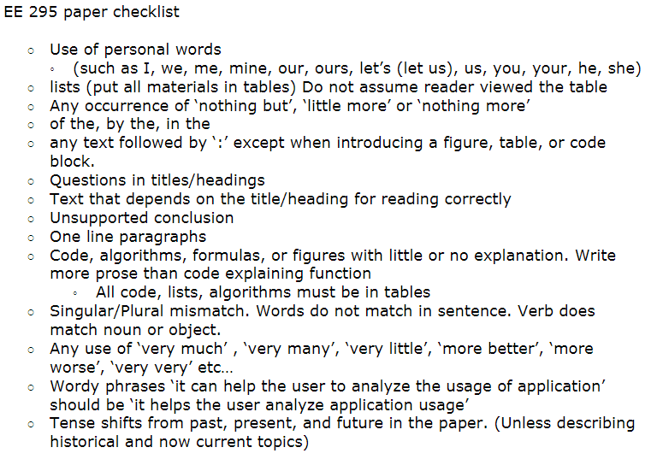
-Morris Jones, EE295 Fall 2016
Minimize use of passive voice. Instead utilize active wording…

Slide 35
Background on EE295 Rules
Limit/Eliminate Personal Pronouns
https://www.editage.com/insights/is-it-acceptable-to-use-first-person-pronouns-in-scientific-writing
Passive Voice
https://www.wikihow.com/Avoid-Using-the-Passive-Voice
Avoid Lists (in the horizontal)
https://www.tu-chemnitz.de/phil/english/sections/linguist/independent/kursmaterialien/TechComm/acchtml/lists.html
Complete Paragraphs have at least 3 sentences
Topic Sentence
Body
Conclusion

Slide 36
Ethics Overview (Eugene Moriarity text)
Engineering
Focal Engineering
Ethics
Ethical Analysis of Engineering

Slide 37
Engineering is
1) an art
2) a science
3) design
4) a profession
5) a business
“Engineering is the practice of making good on the promise of technology.”

Slide 38
Technology creates a tradeoff
Disburdening us from responsibilities
Disengaging us from previously closer involvement with our world
What is desireable is a balance, or focus, where disburdening and disengaging are harmonized
Focal Engineering aims to bring focal products into the world

Slide 39

Seeking the Focal Balance
PRODUCT
RESONANCE
ENGAGEMENT
ENLIVENMENT
END-USER
WORLD

Slide 40
the project, the endeavor, the enterprise, the venture…
the engineering project

Slide 41
Contexts of the engineering project:
the human lifeworld
systems
technological systems
the engineering project
The Engineering Project has Impact beyond simple project borders

Slide 42
Ethical Assessment of the Engineering Project must ultimately take place within the Human Lifeworld.
the human lifeworld
the engineering project

Slide 43
The Human Lifeworld
Wherein we pursue GOALS, enact ROLES, and take up with THINGS of all sorts…
Wherein we talk to each other rather than about each other.
Characterized by a human communication called THE CONVERSATION OF THE LIFEWORLD which is IDEALLY: Mutual / Interdependent / Genuine / Open / Honest / Non-Coercive

Slide 44
The Micro-view of the Engineering Project
the engineering project
The Engineered
The Engineer
Engineering

Slide 45
person / process / product
The Engineer
Engineering
the Engineered

Slide 46
the engineering project
The Engineer
Engineering
Virtue Ethics
Conceptual Ethics
PERSON
PROCESS
The Engineered
Material Ethics
PRODUCT

Slide 47
Three Types of Ethics
VIRTUE ETHICS
Care/objectivity/honesty
CONCEPTUAL ETHICS
Social Justice/Environmental Sustainability/Health & Safety
MATERIAL ETHICS
Engagement/Enlivenment/Resonance

Slide 48
MATERIAL ETHICS
PRODUCT
RESONANCE
ENGAGEMENT
ENLIVENMENT
END-USER
WORLD

Slide 49
Within the Conversation of the Lifeworld the values of resonance / engagement / enlivenment are discussed. For example, “can such and such a product be engaging to the end-user”? “If so, how so”? “If not, why not”?

Slide 50
THREE LEVELS OF ADJUDICATION
VIRTUE ETHICS – corporate level
CONCEPTUAL ETHICS – professional level
MATERIAL ETHICS – social level

Slide 51
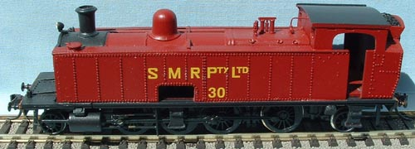
THE ETHICS ENGINE

Slide 52
Over-all Ethical Assessment of the Engineering Project
Integrates all three kinds of ethics.
Can use as point of departure the over-all value function:
J = α J_{v} + β J_{c} + γ J_{m}
where α + β + γ = 1
and we assume all J’s range from -3 to +3.

Slide 53
EXAMPLE: RFID Design
(Person) Virtue Ethics: company ombudsman assesses the team effort as caring/honest/fair so we set J_{v} = +3.
(Process) Conceptual Ethics: professional ethics committee decides that environment is not compromised but social justice can be and health & safety is fine so we set J_{c} = +1.
(Product) Material Ethics: conversation of the lifeworld decides there is no resonance of product with world, end-user in her world is not enlivened, and end-user not engaged with product so we set J_{m} = -3
---- with equal weightings we get over-all J = 0.333 (not so good, etc…)

Slide 54
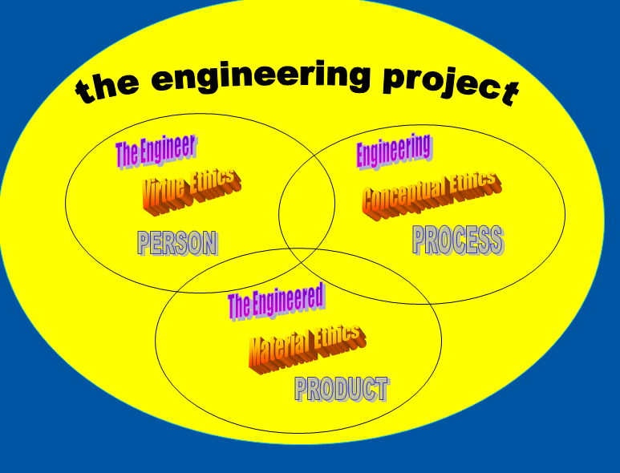
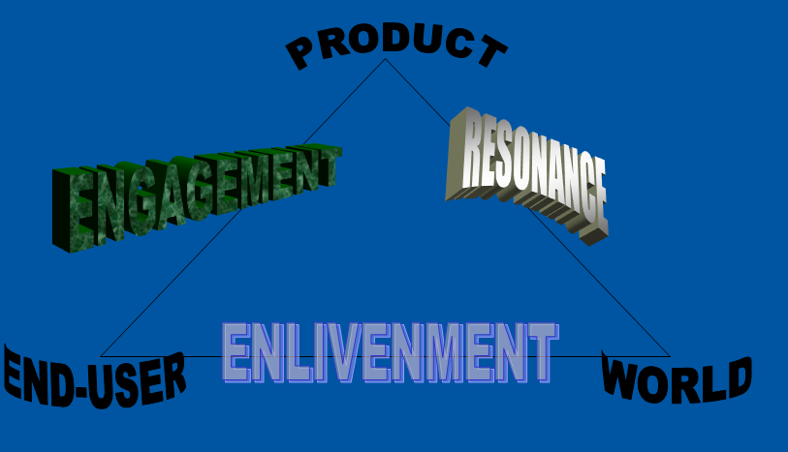

Classic Example of Focal Engineering Project
-The Golden Gate Bridge.

Slide 55
Out of Class Writing Exercise (OOC01)
Submit a paper >600 words (no more than 900) on the differences between science and engineering. Utilize the 6 step approach and the EE295 checklist
Due Sep 12, 2019before 11:59pm
(Lockout at 1am sharp! Sep 13)
10 points

Slide 56
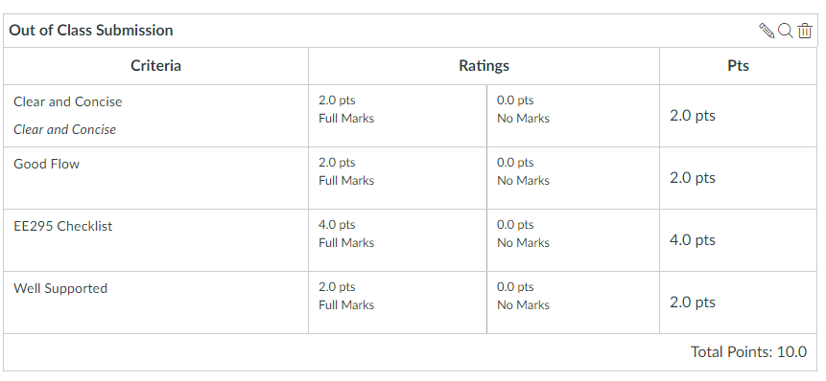
Rubric

